Slide 1
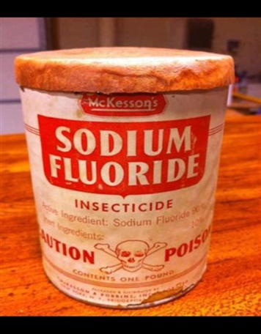
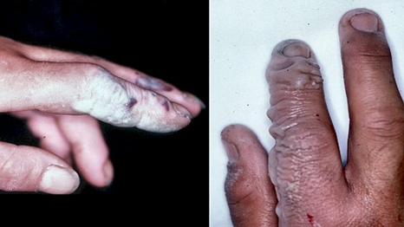
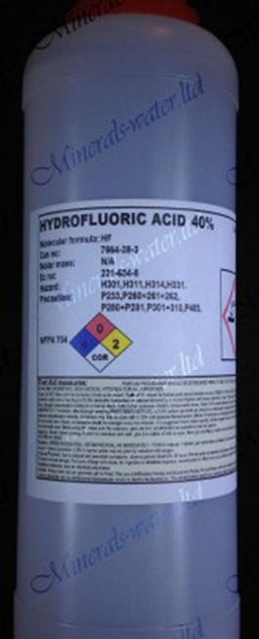
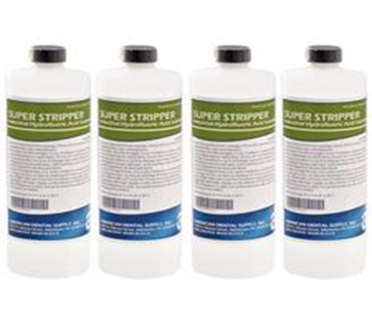
Hydrofluoric acid
Rob Hendrickson, MD
Oregon

Slide 2
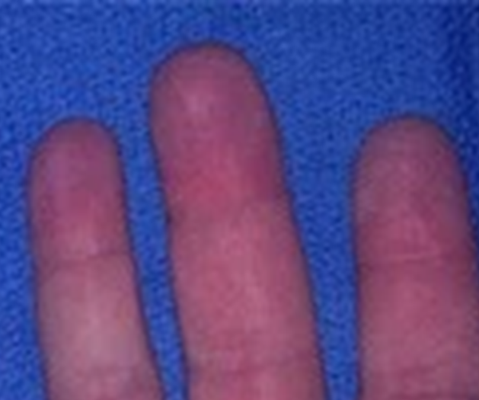
Case
City worker
Removes graffiti from concrete walls
Develops pain in 2nd & 3rd fingertips at the end of the work day
Goes home, pain increases
Arrives to ED at 9pm with excruciating pain

Slide 3
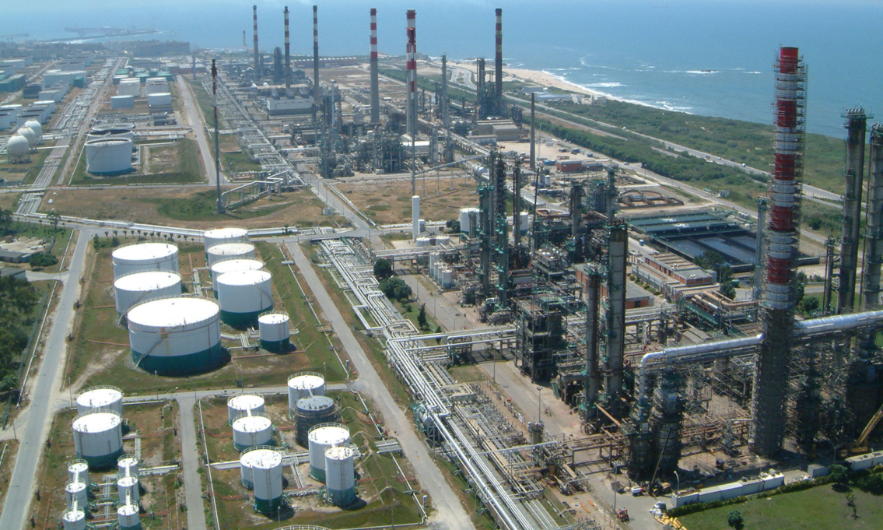
Another case
24,000kg of hydrofluoric acid released from petrochemical plant – spread to nearby community
Notes:
3rd most commonly accidentally-released chemical in US, after chlorine and ammonia.

Slide 4
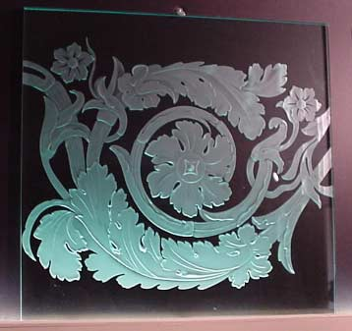
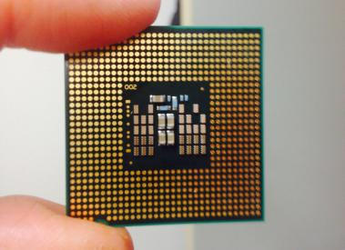

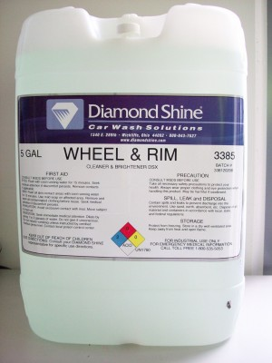
Hydrofluoric Acid
Notes:
Uses:
Removing: Rust, Sand, Scales
Etching: Glass, Silica, Solar Panels, Semiconductors/microchips
Metal Polishing
Electroplating
Rim/Wheel Cleaning
Production: Drug/Dyes(e.g. fluoxetine), Fertilizers, High Octane Fuel, Insecticides, Plastics, Teflon, freon
Insecticide (historically)
Industries: Leather Tanning,
Oil Refining (refining oil – “alkylation” process)- conversion of isobutane/propene/butene into alkylate/isoheptane/isooctane(high octane gasoline components)

Slide 5
Why its different than other acids
Weak acid
HF is able to penetrate deeply into tissue and then dissociate into H⁺ and F⁻
F⁻ binds with extra- and intracellular calcium
  Neuroexcitation, vasospasm →
    Neuropathic pain
    Tissue destruction
  Hypocalcemia → dysrhythmias

Slide 6
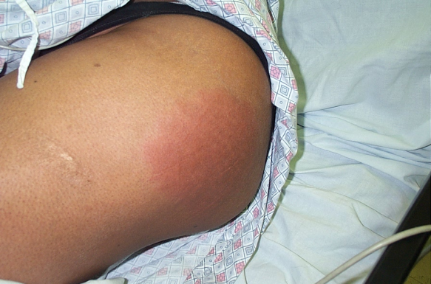

Clinical effects
Local effects – Skin
  Classic red (hyperemia), white (calcium complex precipitates) and blue (coagulative necrosis) sequence

Slide 7
Clinical effects
Local effects – Skin
  Toxicity dependent on body surface area (BSA), concentration, and contact time
    Immediate pain associated with high toxicity
    Life threatening systemic toxicity associated with >2% BSA of high concentration HF

Slide 8
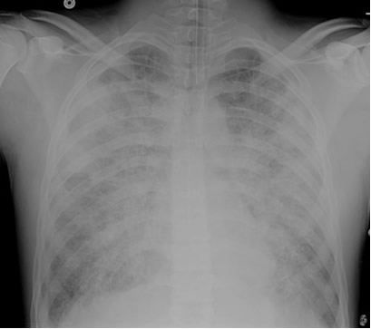
Local Toxicity
Pulmonary – inhalational exposure
  Upper tract – MM irritation, stridor
  Lower tract – wheezing, ARDS

Slide 9
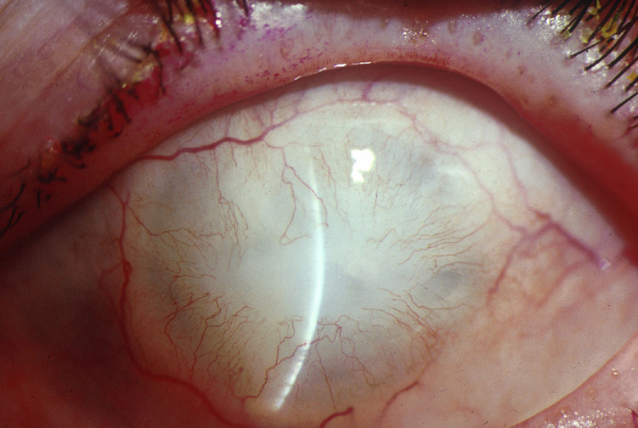
Local Toxicity - Ocular
Usually from vapor/gas
  Also splashes
Corneal edema and ulcerations
Notes:
99% of the time, the acute gastritis is a moot point because ingestions are almost always universally fatal.

Slide 10
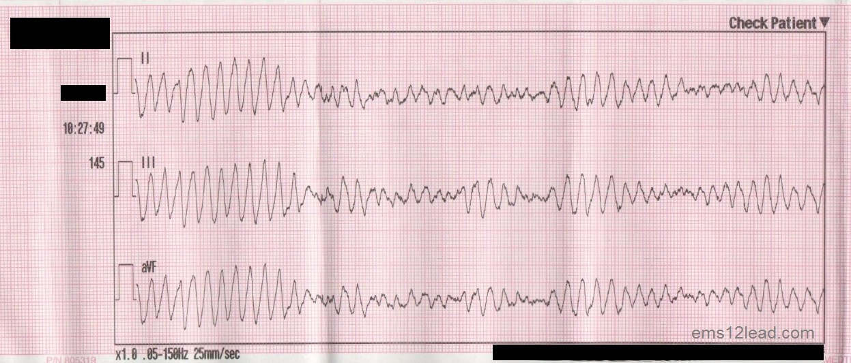
Systemic Toxicity
Hypocalcemia, hypomagnesemia → ventricular dysrhythmias
Preterminal hyperkalemia
  Caused by potassium efflux

Slide 11
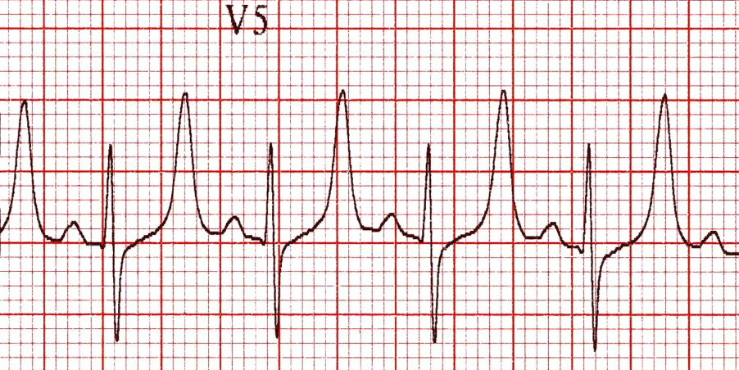
Diagnostics
In patients at risk for systemic toxicity:
  Serial ionized calcium, magnesium, and potassium
  Serial ECGs
hypocalemia, hypomagnesemia
hyperkalemia

Slide 12
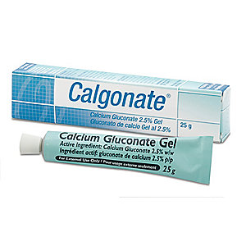
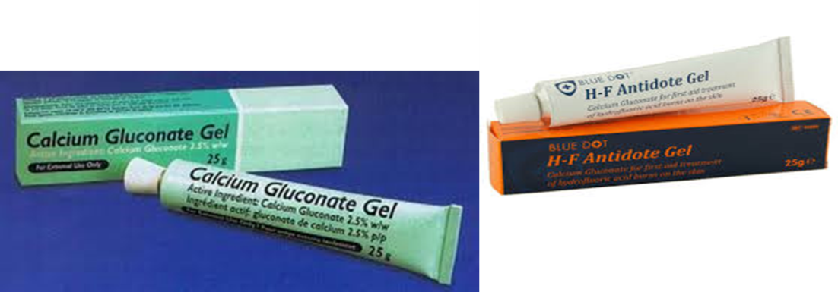
Managing Dermal Toxicity
First step:
  decontamination/irrigation with water or saline
Topical calcium gluconate
  Binds fluoride ions and prevents systemic absorption
  25ml of 10% calcium gluconate in 75ml of lubricant
  Commercially available products
Notes:
Can place in a glove and put glove on for hand/finger exposures

Slide 13
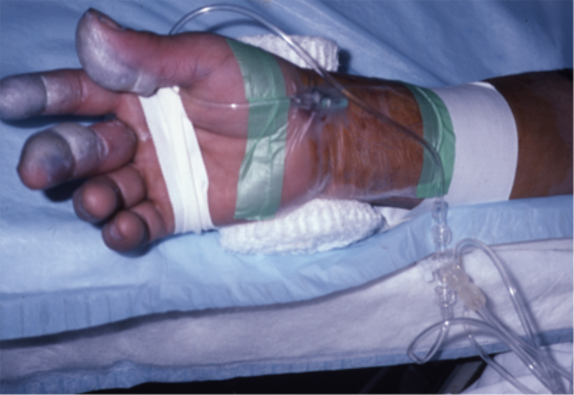
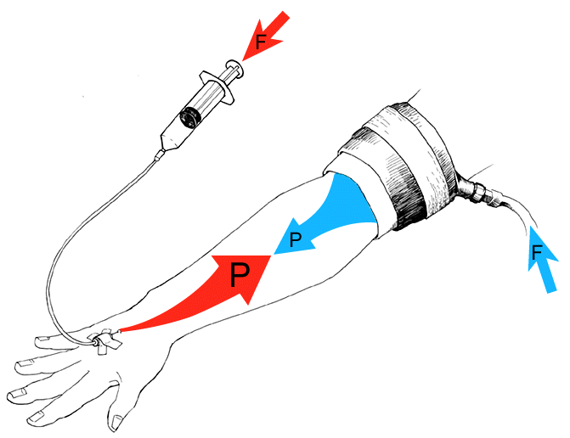
Managing Dermal Toxicity
If topical fails, other options:
  Intradermal: 2.5%, no more than 0.5ml/cm²
  Intravenous Bier block with 50ml of 2.5% calcium gluconate
  Intraarterial: 50ml of 2% calcium gluconate over 4 hours through radial or brachial artery
Notes:
Intradermal is difficult in tight spaces like the fingertips, fingernails, and hand

Slide 14

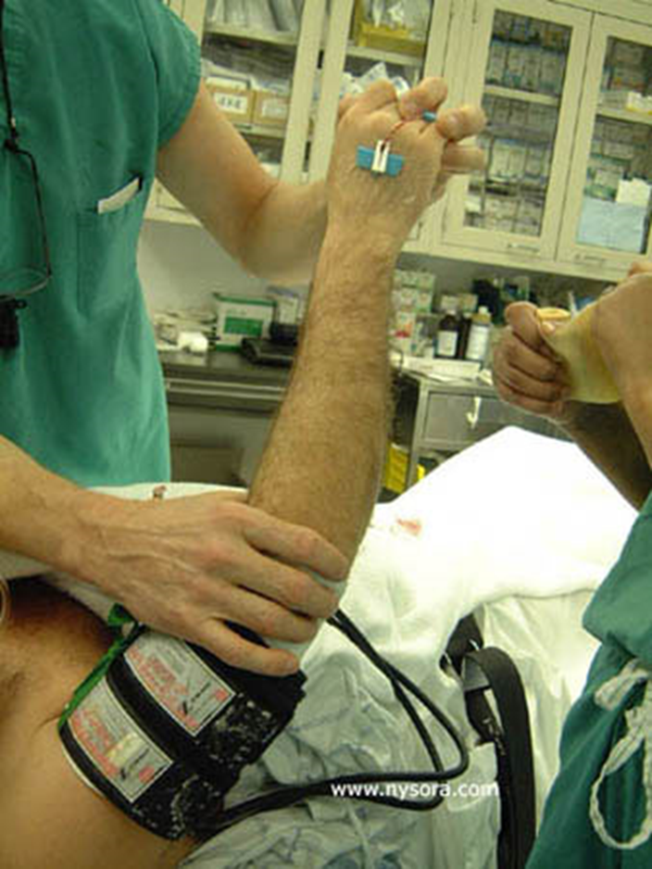

Slide 15
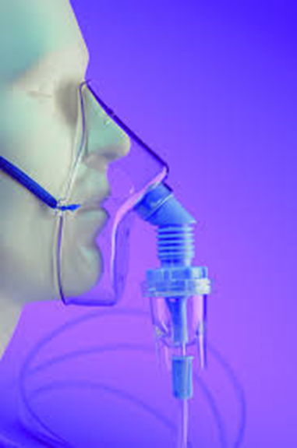
Inhalation
Management
Ingestion
Nebulized calcium gluconate
  4ml of 2.5% solution
Should attempt NG aspiration given almost universal mortality
Calcium or magnesium oral solution

Slide 16
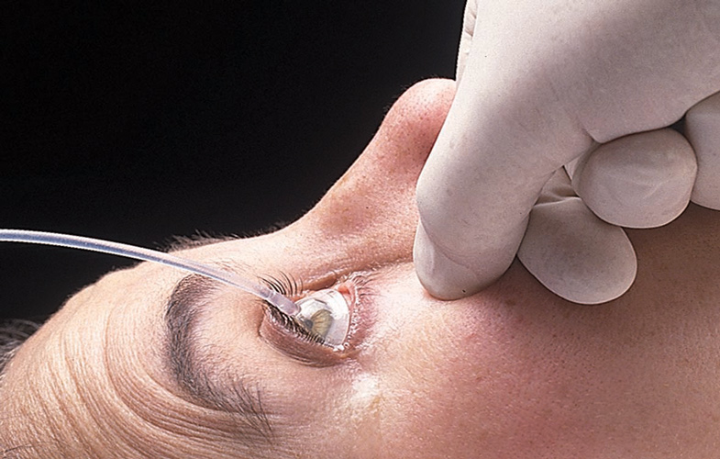
Ocular Toxicity
Irrigate with saline or water
Calcium gluconate(1%) or magnesium have been used, but can be irritating to eye
  Best to consult ophthalmology prior to using calcium or magnesium

Slide 17
Management of Systemic Toxicity
Local calcium and magnesium to limit absorption
Intravenous calcium and magnesium
Intravenous bicarbonate for severe acidosis
  NOTE: calcium and bicarbonate cannot mix in the same IV
Consider dialysis to augment fluoride ion elimination

Slide 18
Worker Safety
PERSONAL PROTECTIVE EQUIPMENT:
  Wear Acid Resistant work gloves for handling:
    neoprene, natural rubber, or nitrile
  Eye/Face Protection:
    Wear safety glasses when handling cylinders;
    Vapor-proof goggles and skin protection and a face shield wherever contact with product is possible
      Chemical-resistant apron with attached sleeves

Slide 19
Worker Safety
Engineering controls
  Fume hoods
  Physical separation
HF spill kit / antidote kit nearby
Employee training

Slide 20
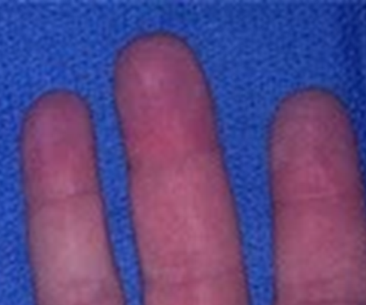
Case
City worker
Removes graffiti from concrete walls
Develops pain in 2nd & 3rd fingertips at the end of the work day
Goes home, pain increases
Arrives to ED at 9pm with excruciating pain

Slide 21
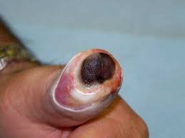
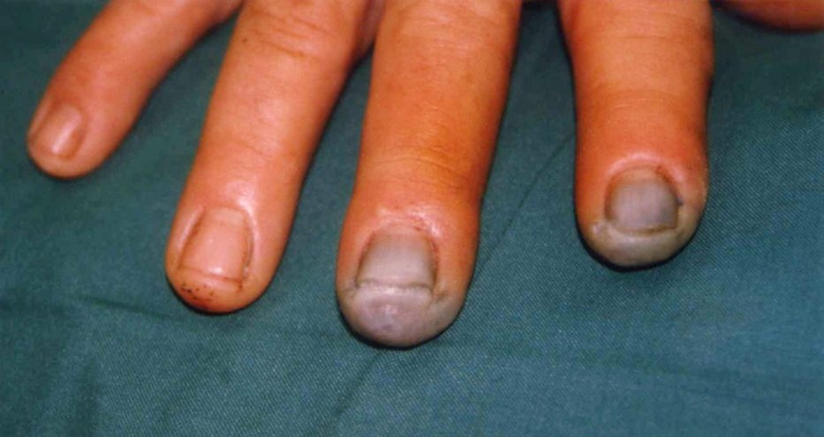
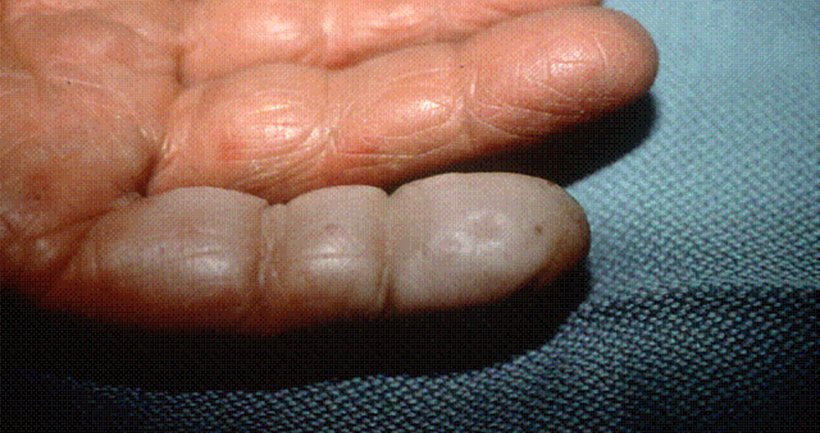
Case
Initial exam reveals mild erythema only
  Initial treatment – topical and SQ calcium gluc
  Intra-arterial calcium infusion

Slide 22
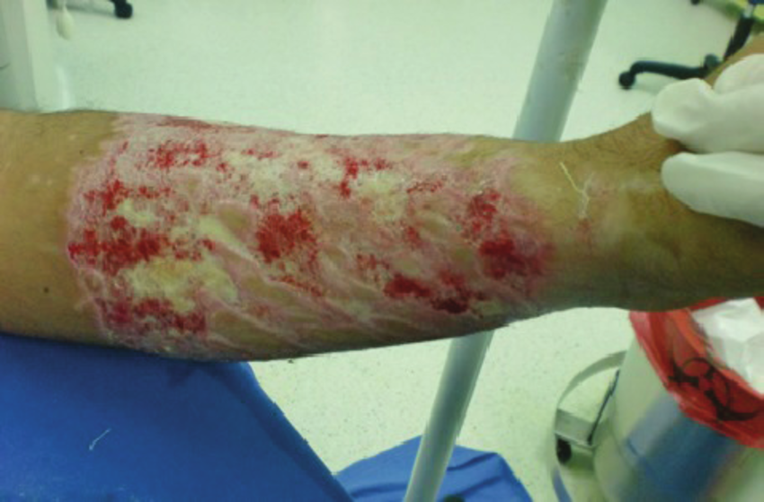
Similar case
Splash to forearm with 35% HF
  Calcium gluconate gel
  Calcium gluconate (2.5%) subcutaneous
  Bier block with 50mL of 2.5% calcium gluconate with relief

Slide 23
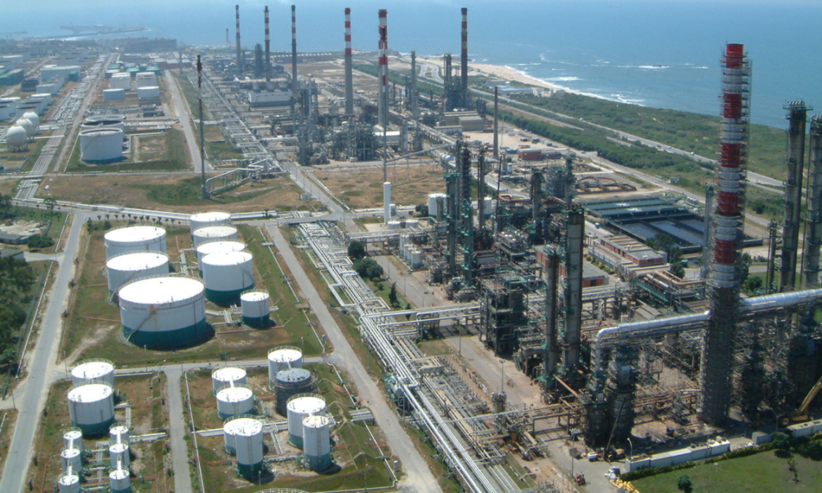
Another case
24,000kg of hydrofluoric acid released from petrochemical plant – spread to nearby community
939 seen in emergency room
ENT irritation, headache, dyspnea
Pulmonary:
  43% with decreased FEV1
  17% hypoxemia
16% hypocalcemia
Notes:
3rd most commonly accidentally-released chemical in US, after chlorine and ammonia.

Slide 24

Questions…??

